Slide 1

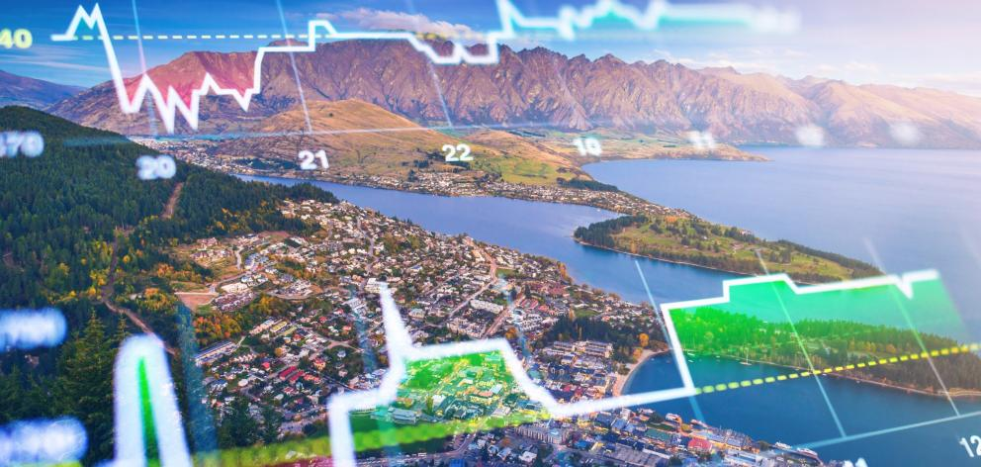

Team Asclepius
Insight into New Zealand Economy
- A data science approach
Notes:
New Zealand is a relatively small economical entity that heavily rely on overseas business. Facing an increasing turbulent international political and economical environment (war and covid-19), in order to maintain our prosperity, in depth analysis on how New Zealand vital economical policy impact on our main economical activities are not only useful but also crucial for the success of these New Zealand companies, such as Air NewZealand, Kiwi Rail and Tourism New Zealand.

Slide 2
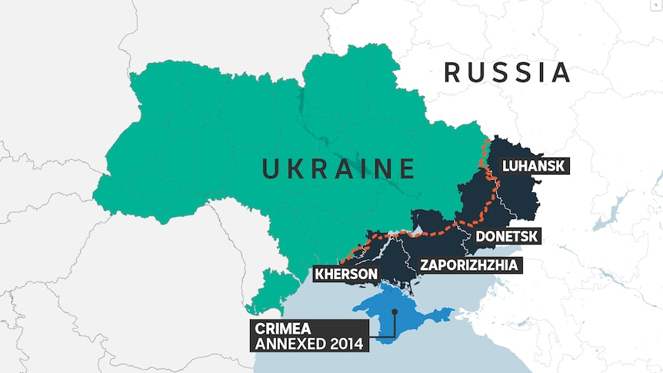

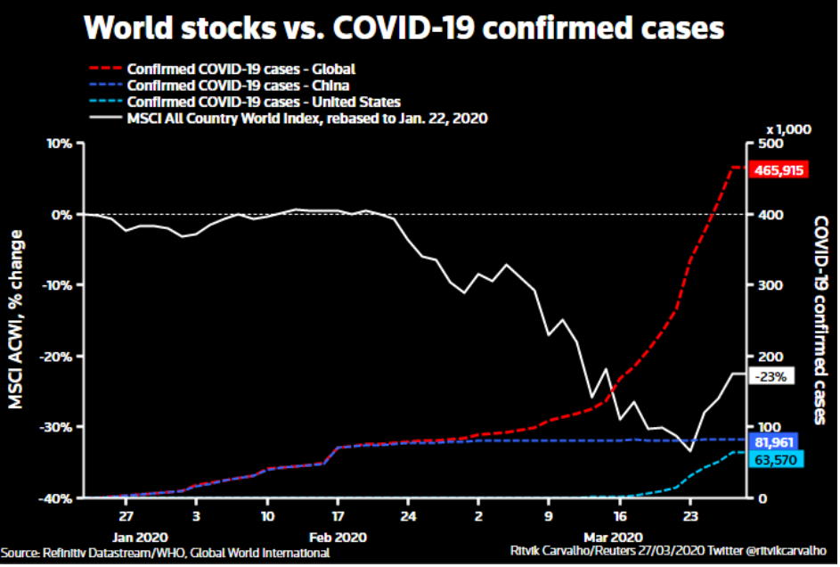
Background
Turbluent International Market caused by political uneasying and COVID-19

Slide 3

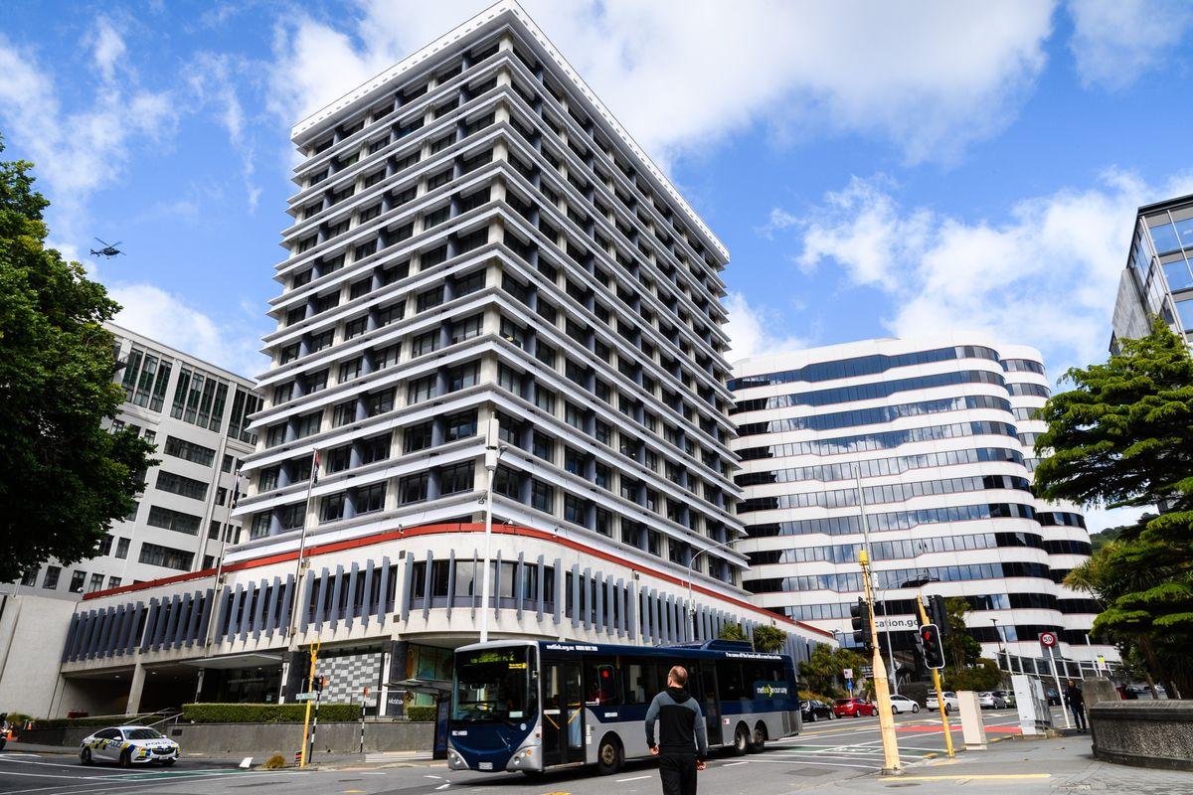
NZ monteary policy impacting the economic
Using reserve bank interest rate / official cash rate
CPI...
Stimulate the economy

Slide 4
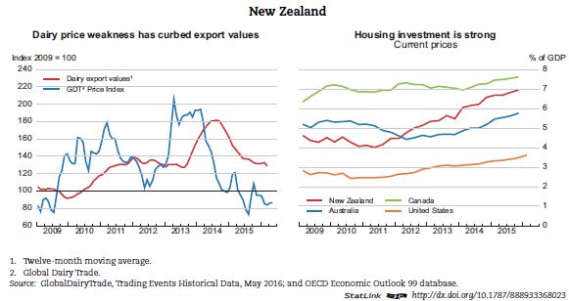
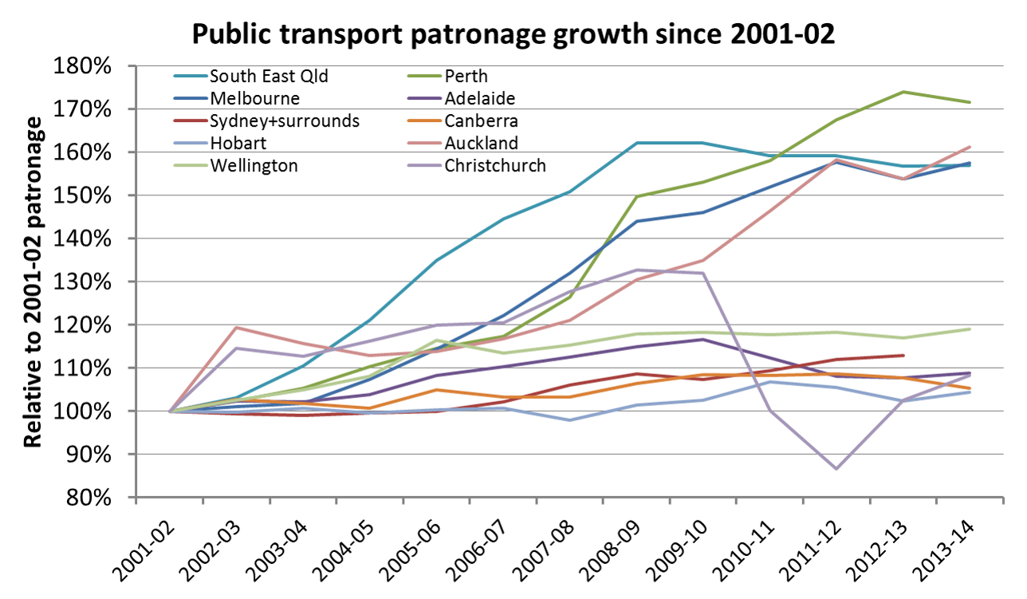
What do we want to collect
https://chartingtransport.com/category/new-zealand-cities/
Historical economical activity data for New Zeland
Transporation (Air, Land...)
Employment / Unemployment Rate
Economical policy data of New Zealand Government
Interest rate
CPI
HPI (optional)
Exchange Rate

Slide 5
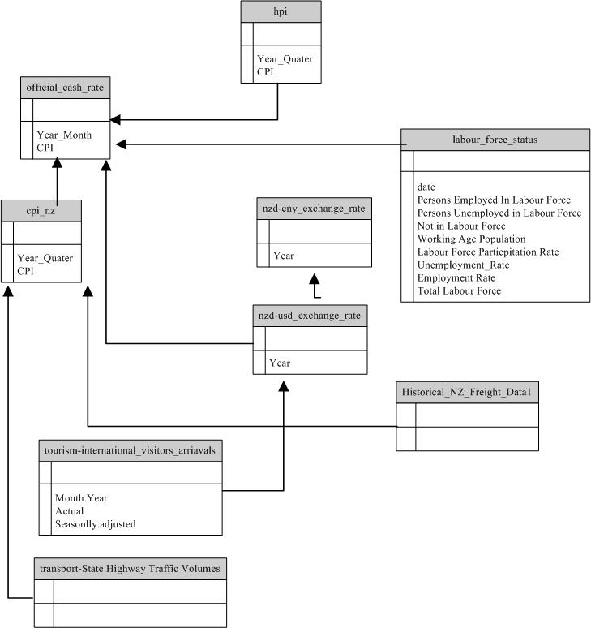
Data model
Official cash rate / Interest rate
Monetary policy influences economic activity by changing the incentives for saving and investment. This channel typically affects consumption, housing investment and business investment. Lower interest rates on bank deposits reduce the incentives households have to save their money.
In our project, we choose “Reserve bank Interest Rate” as primary monetar policy indicators

Slide 6
What target you chose (I.e.n what is the intended use of the data, …)
Review of the hisotrical economic performance VS. policy
Potential to build AI / machine learning algorithm for further forecast ...
1) Our target is to produce a well structured New Zealand economic dataset, that is used to solve economic recession problem. (Output : collect vital NZ ecnoimic indicators for visualization and try to reveal the potential correlation between these indicators. )
Critical review of the NZ monetary policy effectiveness. To coupe with covid-19 lockdown and sequence recession, slowing down to dealing.
2) Potential usage :
The data source we are building is intended to be used for building (visualization) and training prediction model (machine learning) _time series, forecasting . for New Zealand companies.
The potential user of our datasource are targeted to improve their company efficiency.
By analyzing company performance data such as Annual Income VS historical transportation statistics VS. New Zealand Government monetary policy data such as CPI, Exchange Rate, Import Taxation.
Should we include more overseas government data such Import Tax of China, US. Dollar CPI. Join these such data together, we are potentially able to produce a prediction mode trained with these historical data. Utilization of such prediction model will enable company to device forward strategies for increase or decrease production capabilities. Such company strategies will further enable its finance / accounting department on allocate investment budgets as well as income forecasting. Whether or not company should be hiring new employees and purchasing new equipment will depends upon such forward strategies.

Slide 7
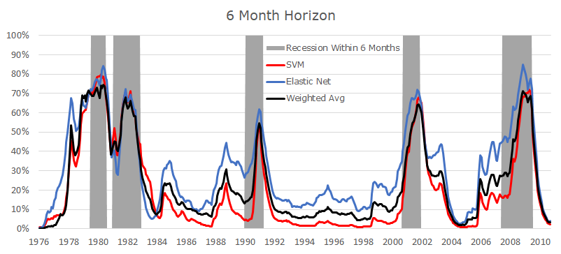
What target you chose (I.e.n what is the intended use of the data, …)
Based on the data we have collected, machine learning / Artificial Intelligence Algorithms could be deployed to conduct prediction on Recession

Slide 8
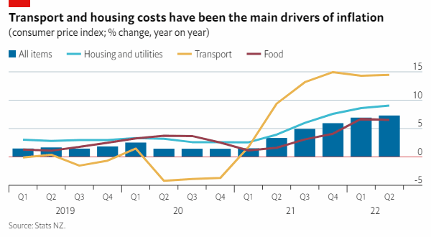
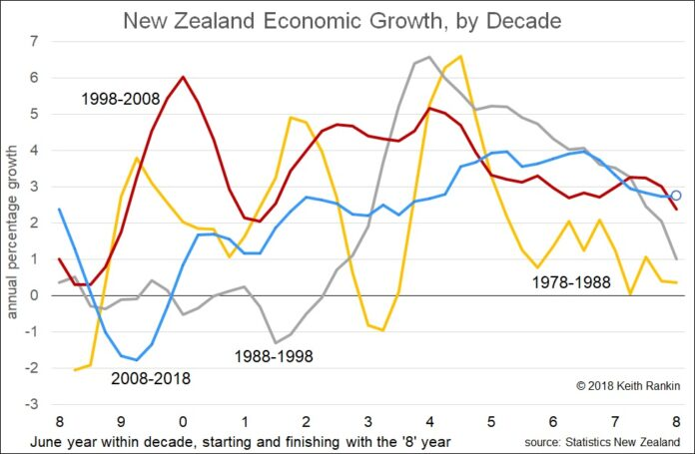
Why do we choose these data sources
To build a solid fundation for further data analysis
To find correlation between these data
https://www.eiu.com/n/will-the-new-zealand-economy-tip-into-recession/

Slide 9
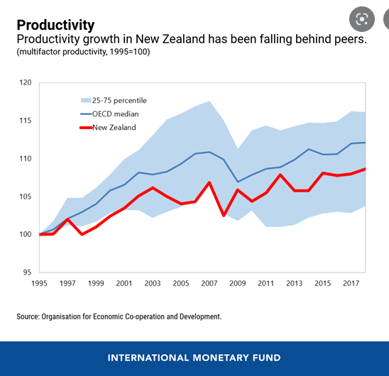
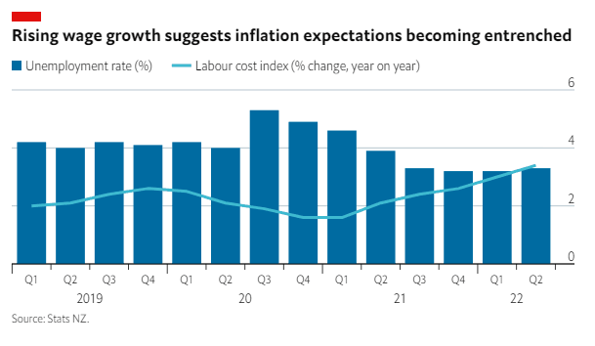
`

Slide 10
Resources used to get data
Data Sources used:
https://infoshare.stats.govt.nz
https://www.interest.co.nz/chart-data/get-csv-data
https://api.ofx.com/PublicSite.ApiService//SpotRateHistory/allTime/NZD/CNY

Slide 11
Techniques and tools used
Techniques used:
Browser Automation
Scrapping
Tools used for scraping and automation:
rvest
RSelenium

Slide 12
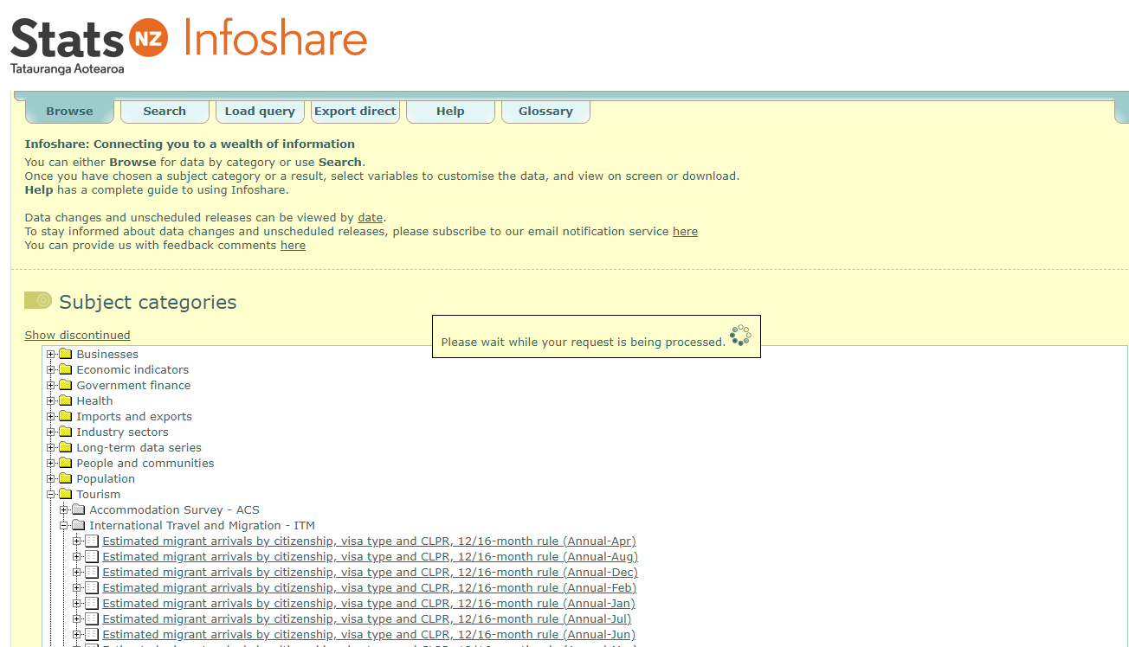
Resources used to get data

Slide 13
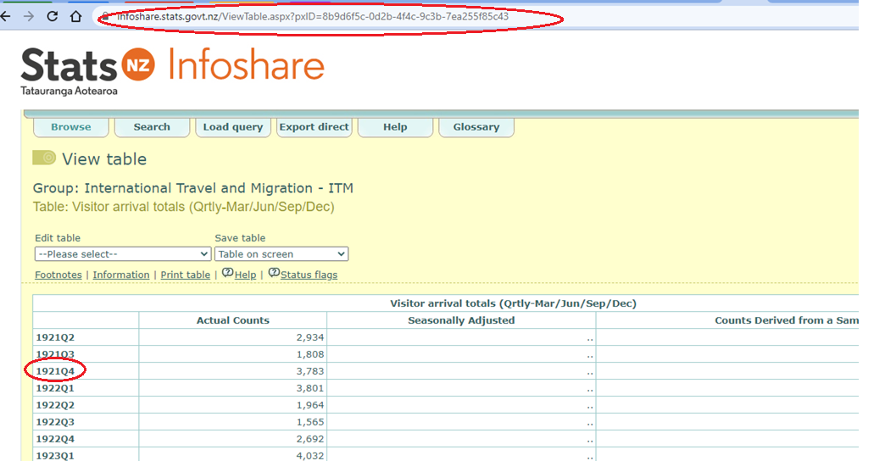
Resources used to get data

Slide 14
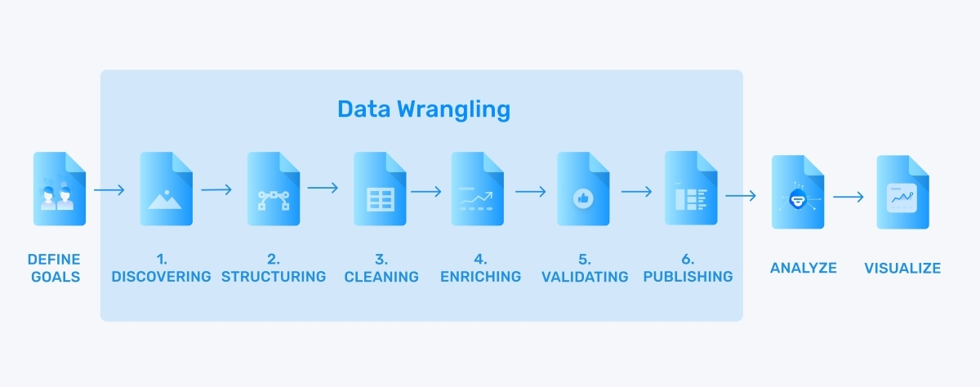
What techniques you did see
Processes applied to data before visualization:
For data scraping, various techniques have been utilized for direct data file downing, web scraping, API calling
(Image taken from: https://monkeylearn.com/blog/data-wrangling)

Slide 15
What you managed to achieve and what you failed to do
API
HPI failed to

Slide 16
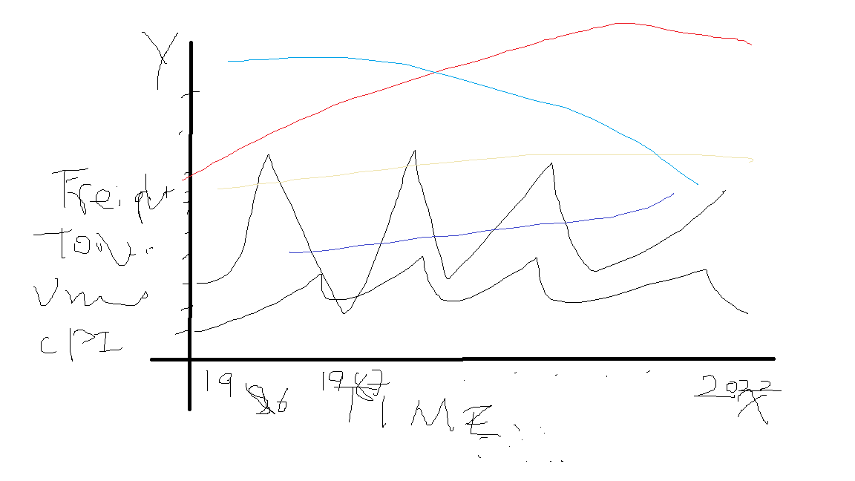
Charts generated to

Slide 17
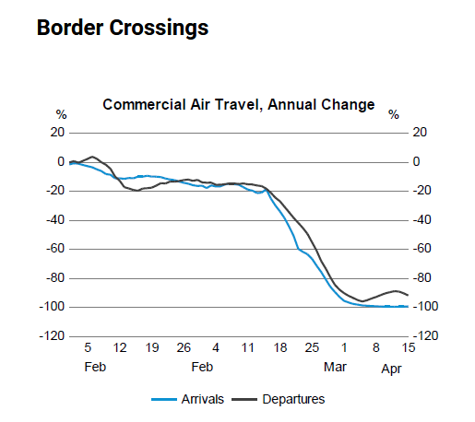
Charts
With increase of the NZDollar USdollar exchange, it is more expensive for tourism coming to New Zealand, we can observe a dropping of the “Tourism International Visitors Arrivals”
2) x axis time (yyyy-mm) : y axis (Tourism international visitors arrivals) + nzd-usd-exchange rate

Slide 18
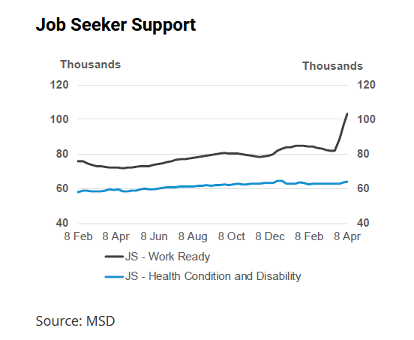
In this chart, it is observable that as OCR increase, in a few months time, the unemployment rate has also increased.
Plot
1) x axis time (yyyy-mm) : y axis (OCR + (Labour force status))

Slide 19
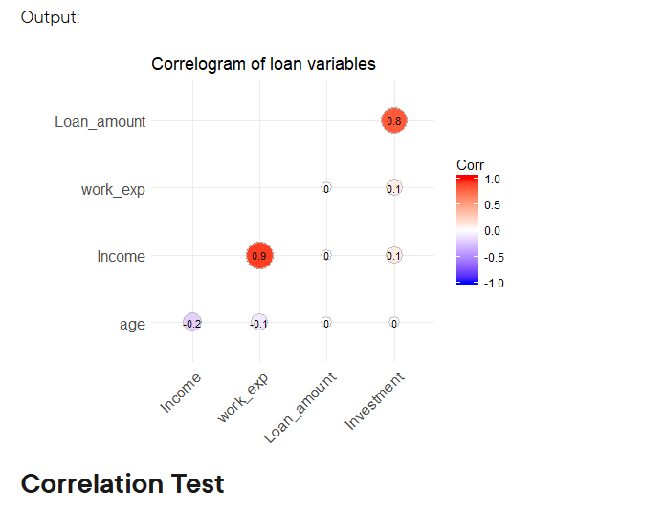
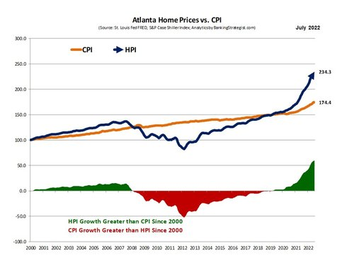
Charts Generated
3) Correlation between “OCR” and CPI
4) Correlation between “CPI” and HPI
5) Correlation between “OCR” and Exchange Rate NZD VS. USD
[If we raise the OCR, banks' interest rates also tend to increase and vice versa.
This is because the OCR influences the banks' costs, so as with any business, changes in costs are passed on in their prices.
A decrease in banks' interest rates usually results in people spending more.]
https://www.bankingstrategist.com/housing-prices-hpi-vs-cpi
3) x axis (OCR from low to high value) : y axis (CPI from low to high value)
[cut in the Official Cash Rate (OCR) leads to an increase in inflation and GDP growth]
[References : https://www.rbnz.govt.nz/-/media/d0024c4168944dc6a502b497cdd5d46c.ashx]
6) Correlation between “OCR” and CPI
7) Correlation between “OCR” and “State Highway Traffic Volumns”

Slide 20
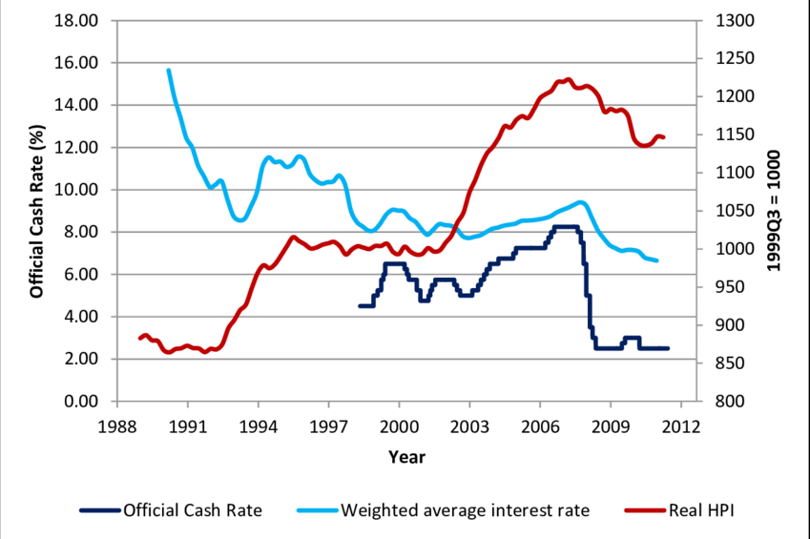
How does Interest Rate Impact HPI
How does Interest Rate of Reserver Bank of New Zealand Impact on house price index (HPI )

Slide 21
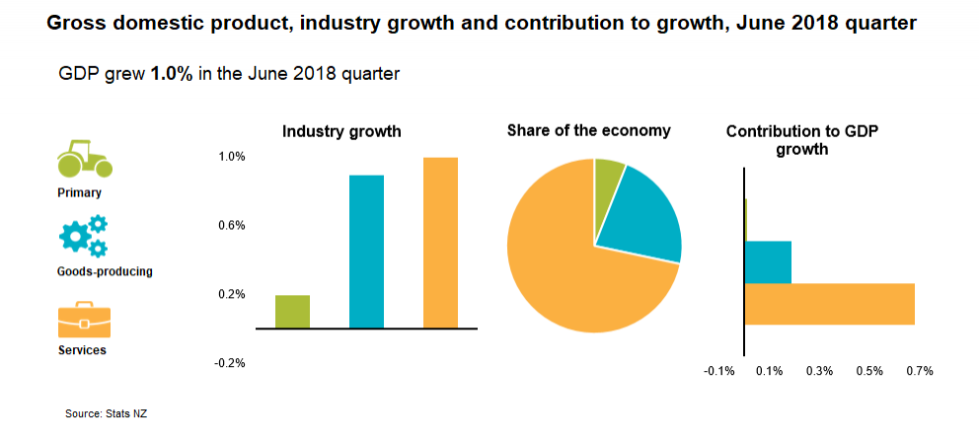
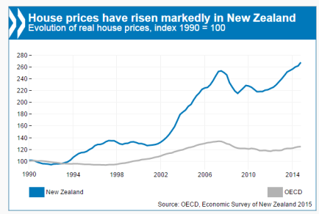
Conclusions
Based on the data we have collected as well as what subsequent plots generated based on that. The following insights have been reviewed.
As New Zealand Reserve Bank sets its interest rate up, various business will have difficult of getting cheap loans for further development, therefore business activities have been reduced, which leads to increase of unemployment.
On the other hand, increase of Reserve Bank interest rate will attract oversea hot money for short term investment, therefore it is anticipated that exchange rate of New Zealand dollars VS. Other currency will go up. The high Reserve bank interest rate will lead to lower level of economic activities, hence in term of cargo freight statistics, general vehicle activities and tourism account, we are anticipating dropping in these activities.
However, Reserve Bank raise interest rate usually to combat high inflation rate (CPI), therefore, we should be expecting dropping of the CPI.

Slide 22
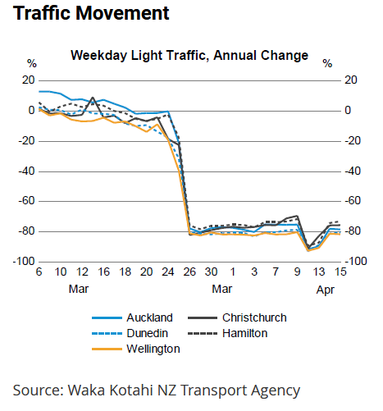
When the economic activities are low and unemployment rate is high
New Zealand government is under pressure to unleash new monetary policies to stimulate economy. Hence government usually resolve to lower reserve bank interest rate.
With high reserve bank interest rate, we should be able to observe weak New Zealand dollars VS US dollars. Thus make export of our products cheaper, therefore attracts more oversea orders, subsequently we should be able to observe an increase of freight transportation activities, oversea passage flights.
To stimulate general economic growth, government usually starts major infrastructural projects like major road works, etc. Hence it is also anticipated that general road construction activities are increasing.
https://www.treasury.govt.nz/publications/weu/weekly-economic-update-17-april-2020-html

